Slide 1
Lecture 5
Informed Search Strategies

Slide 2
Heuristics
Heuristic means “rule of thumb”.
Judea Pearl
  “Heuristics are criteria, methods or principles for deciding which among several alternative courses of action promises to be the most effective in order to achieve some goal”.
Heuristics are used to identify the most promising search path.

Slide 3
Example of Heuristic Function
A heuristic function at a node n is an estimate of the optimum cost from the current node to a goal.
It is denoted by h(n).
h(n) = estimated cost of the cheapest path from node n to a goal node

Slide 4
Example of Heuristic Function
Example 1:
  We want a path from Islamabad to Lahore
  Heuristic for Lahore may be straight-line distance between Islamabad and Lahore
  h(Islamabad) = euclideanDistance(Islamabad, Lahore)

Slide 5
Example 2:
  8-puzzle
  Misplaced Tiles Heuristics is the number of tiles out of place.

Slide 6
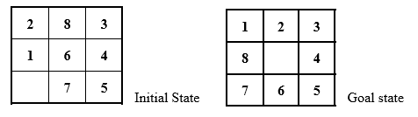
  8-puzzle

Slide 7
Euclidean Distance Heuristic for 8-puzzle
The first picture shows the current state n, and the second picture the goal state.
h(n) = 5 because the tiles 2, 8, 1, 6 and 7 are out of place.

Slide 8
Manhattan Distance Heuristic for 8-puzzle
Manhattan Distance Heuristic:
  Another heuristic for 8-puzzle is the Manhattan distance heuristic.
  This heuristic sums the distance that the tiles are out of place.
  The distance of a tile is measured by the sum of the differences in the x-positions and the y-positions.
  Using the Manhattan distance heuristic, h(n) = 1 + 1 + 0 + 0 + 0 + 1 + 1 + 2 = 6

Slide 9
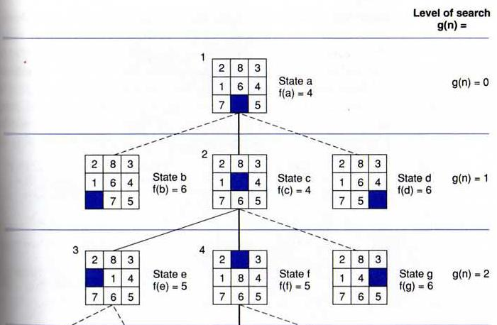
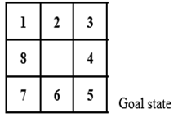
State space generated in Manhattan Distance heuristic search of the 8-puzzle

Slide 10
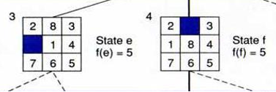
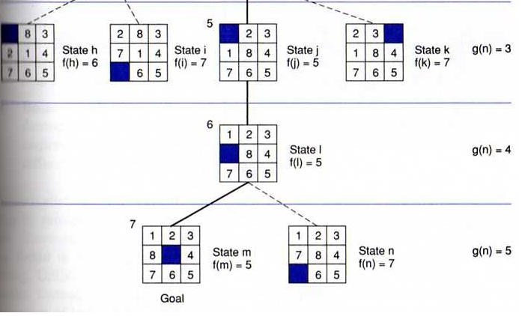
State space generated in heuristic search of the 8-puzzle

Slide 11
Best First Search
The algorithm maintains a priority queue of nodes to be explored.
A cost function f(n) is applied to each node.
The nodes are put in OPEN in the order of their f values.
Nodes with smaller f(n) values are expanded earlier

Slide 12
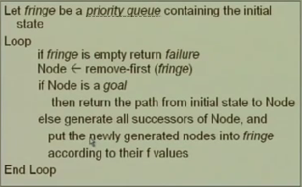
Best First Search

Slide 13
Greedy Best First Search
Idea:
  Expand the node with the smallest estimated cost to reach the goal.
  Use a heuristic function f(n) = h(n)
  h(n) estimates the distance remaining to a goal.
  Not optimal.
  Incomplete

Slide 14
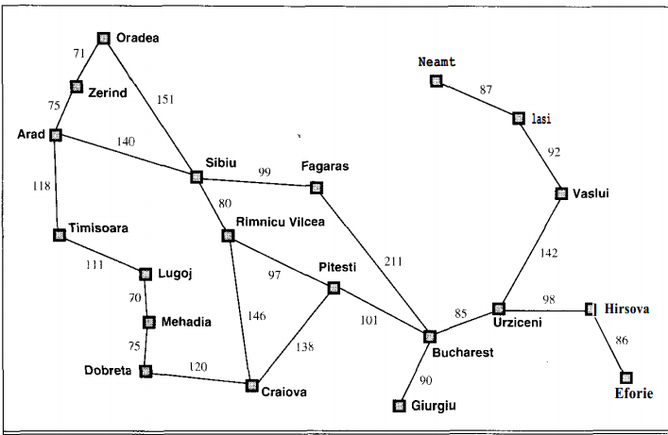
Map of Romania with road distances in km

Slide 15
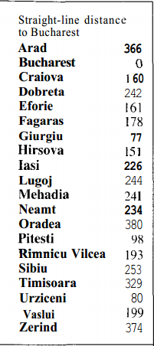
straight-line distances to Bucharest.

Slide 16
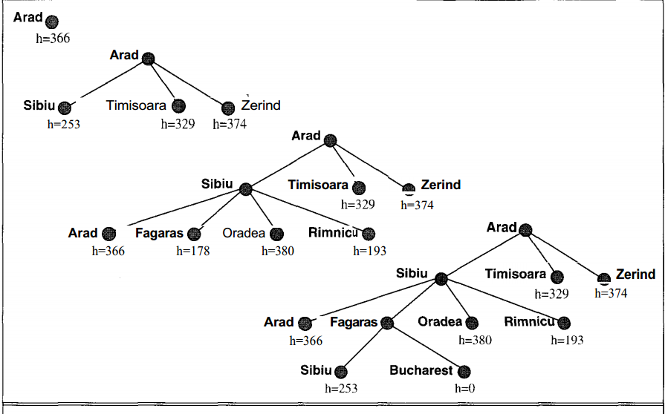
Stages in a greedy search for Bucharest, using the straight-line distance to Bucharest

Slide 17
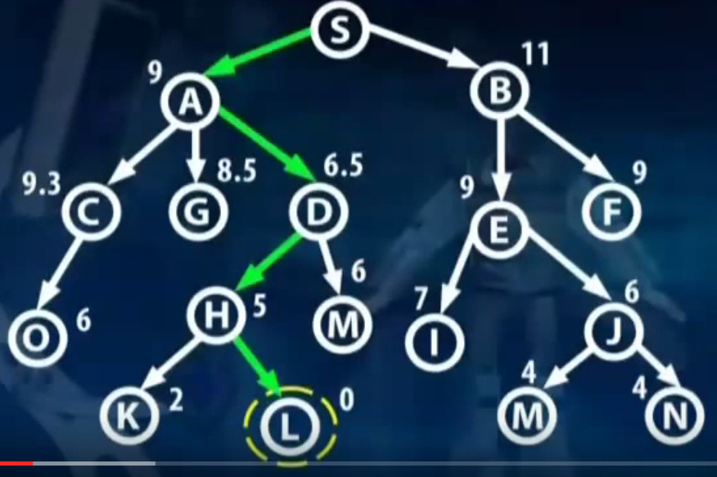
Best First Search (All options open)

Slide 18
Properties of Greedy Best First Search
Greedy search resembles depth-first search in the way it prefers to follow a single path all the way to the goal, but will back up when it hits a dead end.
It suffers from the same defects as depth-first search
It is not optimal.
It is incomplete because it can start down an infinite path and never return to try other possibilities.

Slide 19
Properties of Greedy Best First Search
Time & Space complexity:
  The worst-case time complexity for greedy search is O(b power (m), where m is the maximum depth of the search space.
  Because greedy search retains all nodes in memory, its space complexity is the same as its time complexity.
  With a good heuristic function, the space and time complexity can be reduced substantially. The amount of the reduction depends on the particular problem and quality of the h function

Slide 20
Hill climbing
Maximize “value” of current state, by replacing it by successor state that has highest value, as long as possible.
Use heuristic to move only to states that are better than the current state.
The process ends when all operators have been applied and none of the resulting states are better than the current state.
No search tree is maintained, only the current state.

Slide 21
Hill climbing: Algorithm
Greedy approach, No backtracking, only store current best
Only store the best node in memory
Algorithm:
  1. determine successors of current state
  2. choose successor of maximum goodness
  3. if goodness of best successor is less than current state's goodness, stop
  4. otherwise make best successor the current state and go to step 1

Slide 22
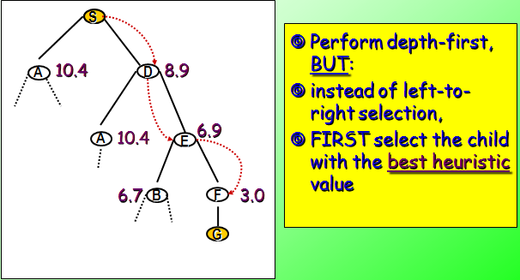
Hill climbing: Example

Slide 23
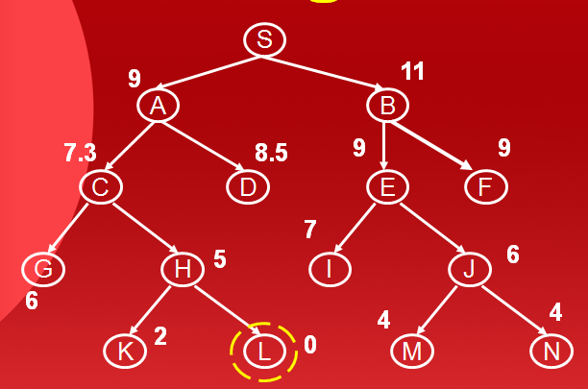
Hill Climbing
S
9
11
A
B
7.3
8.5
9
9
C
D
E
F
7
G
H
5
I
J
6
6
4
4
K
2
L
0
M
N

Slide 24
Hill climbing: Problems
Local maxima:
  Once the top of a hill is reached the algorithm will halt since every possible step leads down.
Plateaux :
  If the landscape is flat, meaning many states have the same goodness, algorithm degenerates to a random walk.
Ridges :
  If the landscape contains ridges, local improvements may follow a zigzag path up the ridge, slowing down the search

Slide 25
Problems with
Hill climbing
Foothills:
Plateaus
Local
maximum
Ridges

Slide 26
Random-restart hill-climbing
Random-restart hill-climbing is a variant in which reaching a local maximum causes the current state to be saved and the search restarted from a random point.
After several restarts, return the best state found. With enough restarts, this method will find the optimal solution.

Slide 27
Beam search
Narrowing the width of the breadth-first search

Slide 28
Beam search (1):
Depth 1)
S
Assume a pre-fixed WIDTH (example : 2 )
Perform breadth-first, BUT:
Only keep the WIDTH best new nodes
  depending on heuristic
at each new level.
10.4
8.9
A
D
Depth 2)
S
S
A
D
6.7
8.9
10.4
6.9
B
D
A
E
X
ignore
X
ignore

Slide 29
Beam search (2):
Depth 3)
S
A
D
Optimi-zation: ignore leafs that are not goal nodes
4.0
B
D
A
E
6.9
X
X
6.7
3.0
C
B
F
_
end
E
X
ignore
Depth 4)
S
A
D
B
D
A
E
C
X
X
B
F
_
E
X
10.4
0.0
A
C
_
G

Slide 30
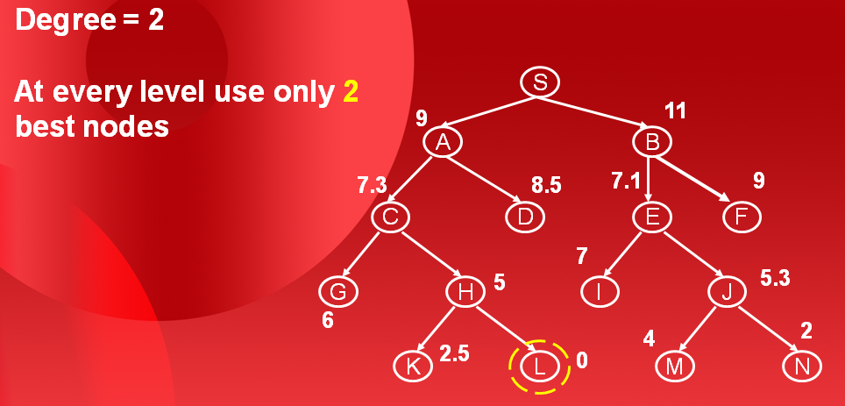
Beam Search
Degree = 2
At every level use only 2
best nodes
S
9
11
A
B
7.3
8.5
7.1
9
C
D
E
F
7
G
H
5
I
J
5.3
6
2
4
K
2.5
L
0
M
N

Slide 31
Properties
Since a goal state could potentially be pruned, beam search sacrifices completeness (the guarantee that an algorithm will terminate with a solution, if one exists).
Beam search is not optimal (that is, there is no guarantee that it will find the best solution). It returns the first solution found.
Beam search is not complete
Space complexity is constant
Time complexity NlogN

